Slide 1
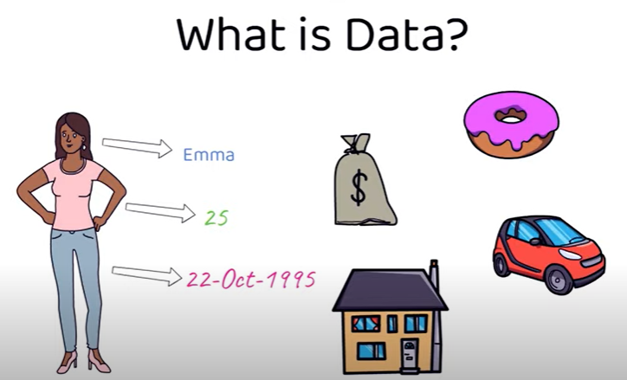
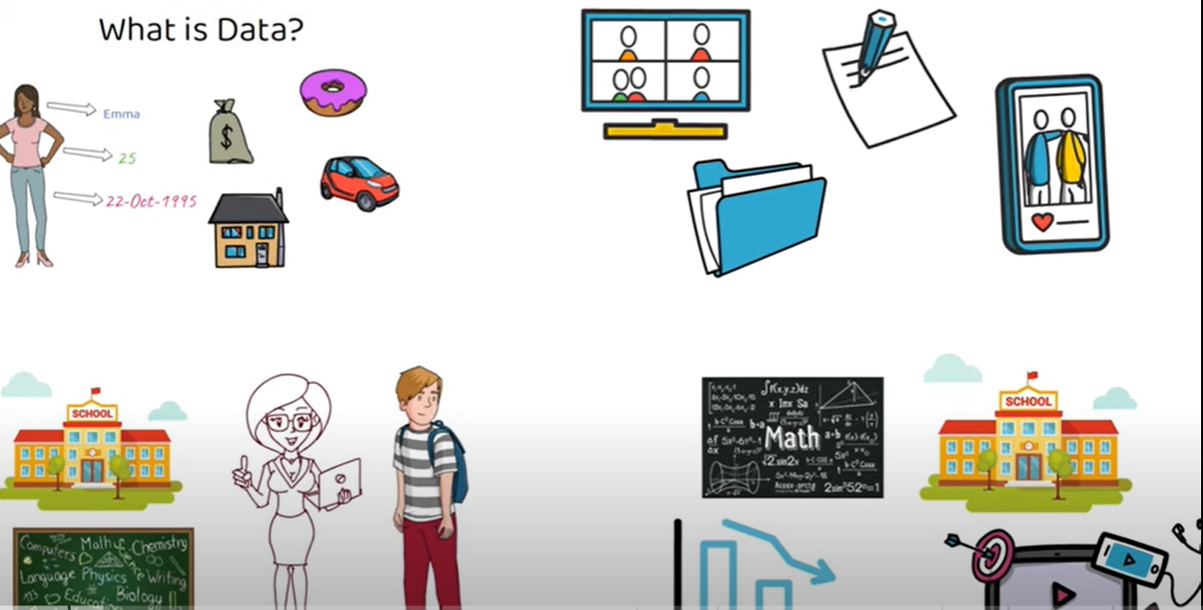

WHAT IS DATABASE ? TYPE OF DATABASE ? WHAT IS DBMS ? (DATABASE MANAGEMENT SYSTEM)
WHAT IS DATA ?
- Person name, Age, DOB , House Address , Bank Balance, Vehicles , School Details, Technology, Statistics, Food we eat can be considered as data.
- Also data can be any form like Image, video, Text, Document.
- This Data will stored in DATABASE.

Slide 2
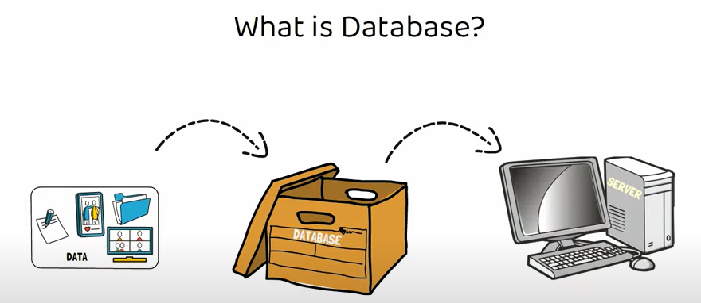
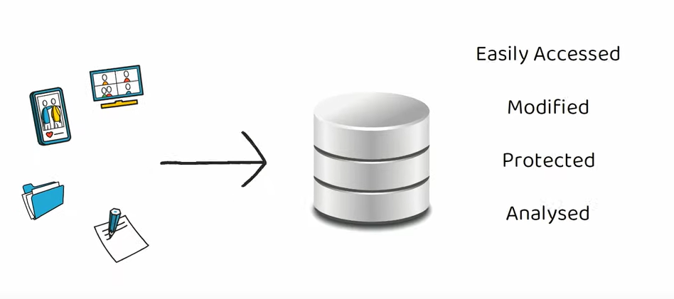
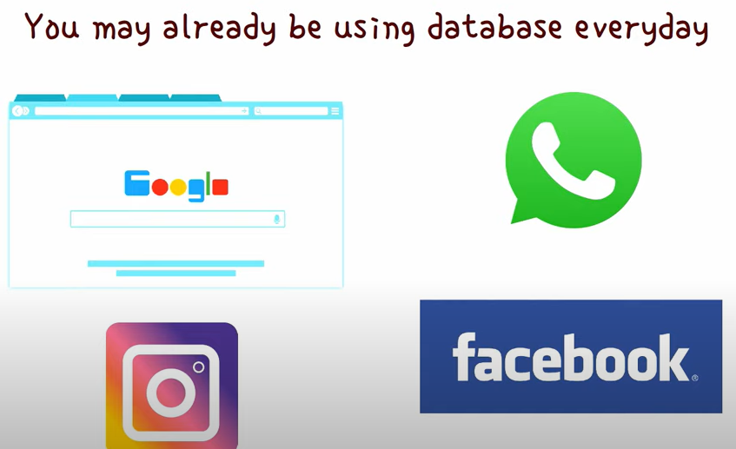
WHAT IS DATABASE ?
MANY FORM OF THE DATA CAN BE STORED IN THE DATABASE HELP TO STORE THE DATA
DATABASE CAN BE STORED IN THE CONTAINER FILL WITH DATA OR INFORMATION WHICH STORED IN THE COMPUTER SYSTEM & MANY REGULAR APPLICATION USING DATABASE EVERYDAY
THE PURPOSE OF STORE THE DATA IS – EASILY ACCESSED, MODIFIED,PROTECTED,ANALYSED

Slide 3
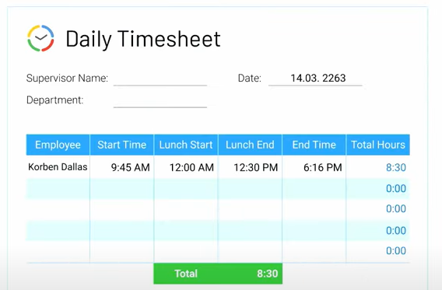
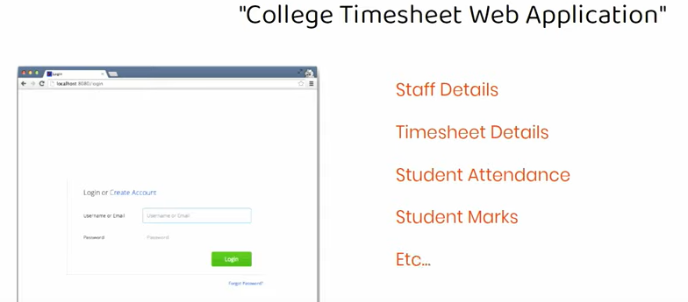
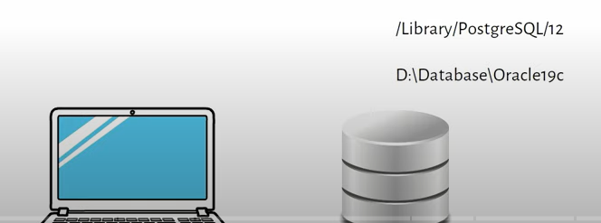
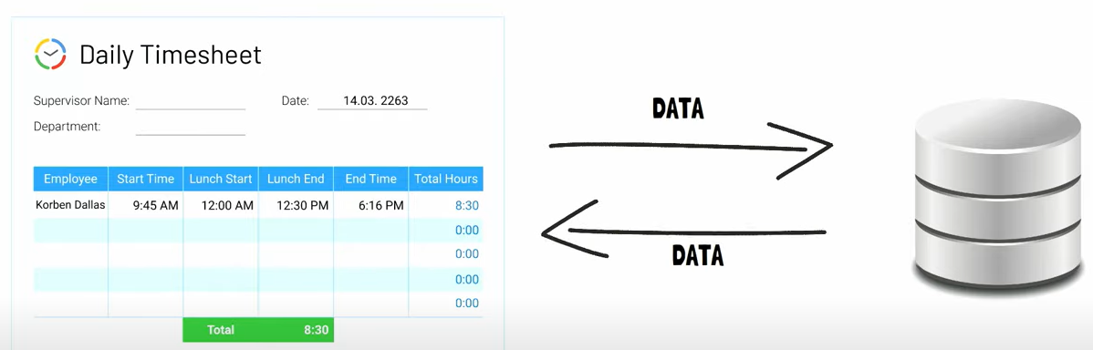
Wanted to create web application – COLLEGE TIMESHEET WEB APPLICATION
If user wanted to create web application basically this application should login through URL & then option to enter staff detail, timesheet detail, student attendance, student marks etc.
Since this college demo project student will use personal laptop to develop this project.
1st thing your application need is database to store & retrieve the data . Hence you need to install the database which connect to time sheet application like any other software install in your application & Database also allocate specific location in computer hard drive.
Through your web application whenever try to save, edit or retrieve the information.
The application will connect to the DB to store, modified or extract the data.

Slide 4
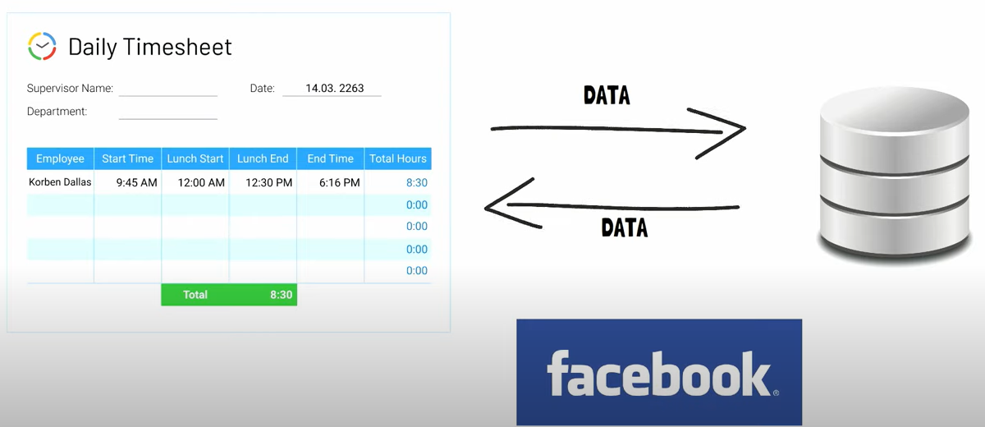
- Since the database installed in the computer data is stored in your computer memory.
- This is simple application we understand how we store the data, retrieve the data.
- In organization for bigger application bigger company they need to huge data to store huge database which may installed in large server. That’s why we called as server is collection of database. All application use database.
- Image, video, post or any other information that you see in social media like facebook (meta) is actually stored in database. whenever user search the data then for specific post or specific details of user data will retrieve from the database.

Slide 5

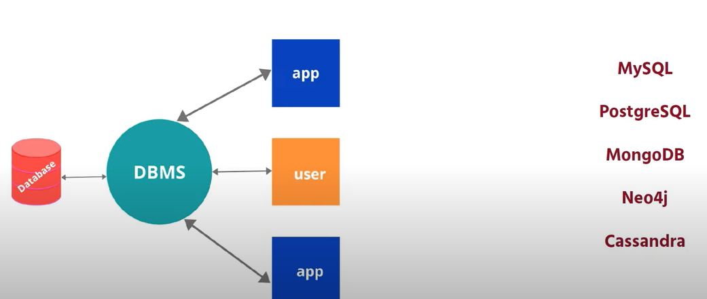
Does Data Base same as DBMS. That’s not entirely correct.
Database – container that stores the data
DBMS is software used to manage the database . Need Dbms to interactive with database to store modify, retrieve and protect the data.
DBMS also required to create, modify or delate database
Users like you and me to enter command can use dbms to enter command in specific language to interact with database.
Popular of DBMS are → MYSQL, POSTGRESQL, MICROSOFT SQL SERVER, ORACLE DATABASE,SQLITE, MONGODB, REDIS, CASSANDRA, SQLITE

Slide 6
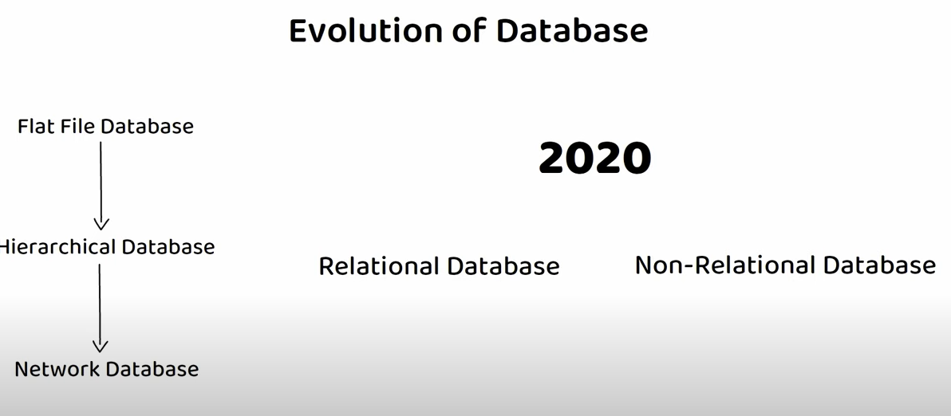
EVOLUTION OF DATABASE
FLAT FILE DATABASE : A flat-file database is a type of database that stores data in a simple, two-dimensional table, typically a plain text file flat-file databases do not use multiple tables or complex relationships between tables. or a spreadsheet.
HIERARCHICAL DATABASE: organizes data in a tree-like or hierarchical structure. In this model, data is represented in a parent-child relationship, where each record (or node) has a single parent record except for the root, and each parent can have multiple children. The structure resembles an upside-down tree or an organizational chart.
NETWORK DATABASE: represents data using a network model. In this model, data is organized as a collection of records, and the relationships between records form a network structure. Unlike hierarchical databases, where each record has a single parent, network databases allow records to have multiple parents, enabling more flexible and complex relationships.

Slide 7
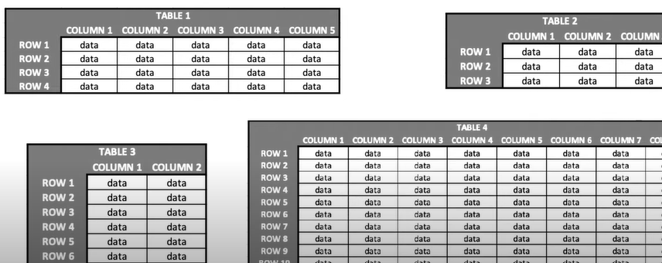
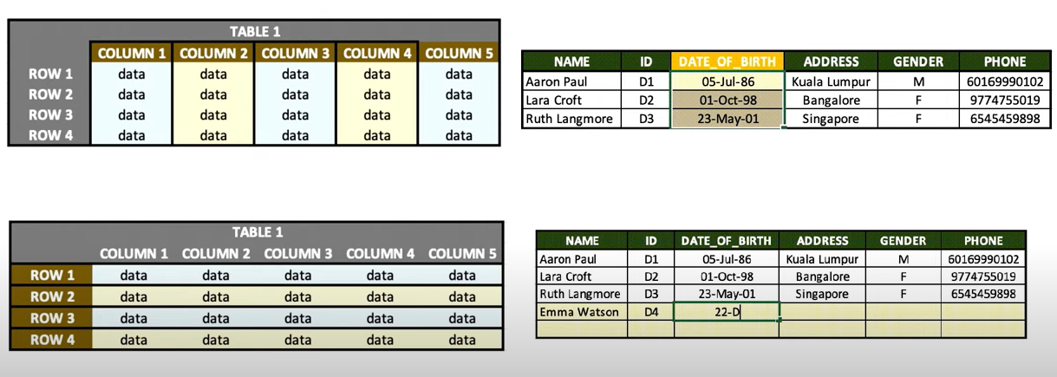
REALATIONAL DATABASE = SQL DATABASE = STRUCTURED DATA
Relational database data can be stored in the table.
Each table consist of rows & columns
Each columns has name & data type
Each row can be treated as record which formed by single or multiple columns

Slide 8
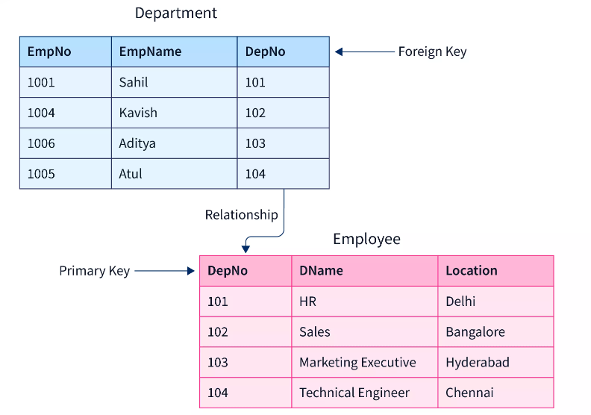
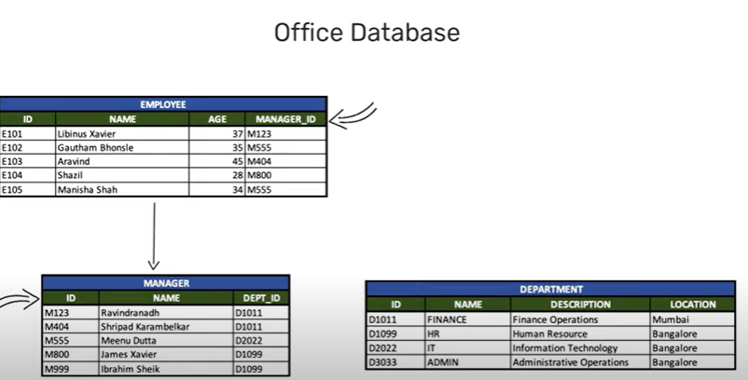
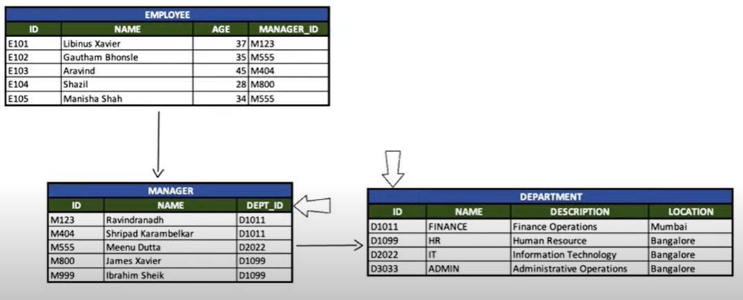
- As an example if you considered as office database it will have information relation to employee, manager & department. These details are stored in different table. - These table are related through certain columns Employee & Manager table are related through manager id # column because - which is present in both table. Hear manger id is FOREIGN KEY - Manager & Dept table are related through dept_id. Emp & dept table are not related to each other but still it is possible to fetch the data from emp table based on specific condition from dept table. This is how Relational DB works

Slide 9
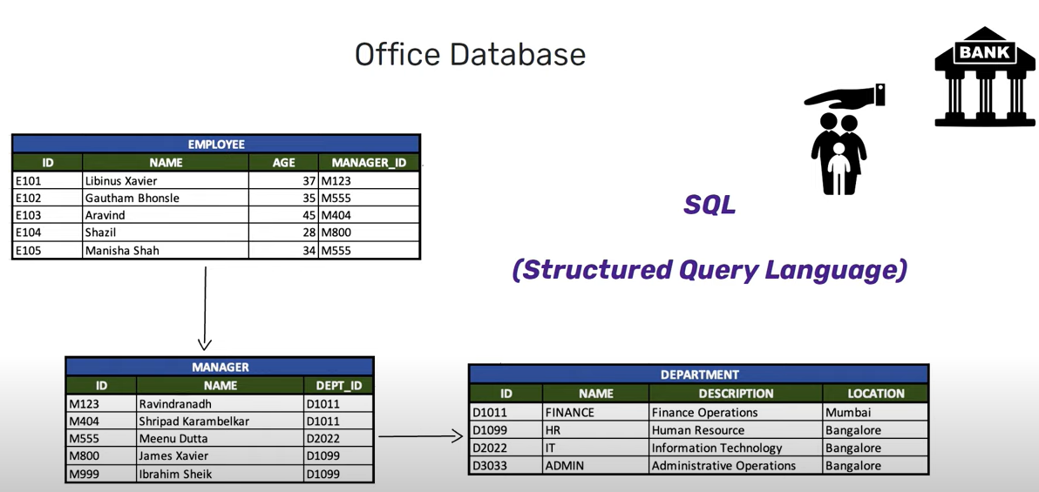
- Information try to retrieve from multiple tables which are related to one another. Hence using table relation it is possible to retrieve data from different tables.
- In relational database using dbms you can enter command to specific language to store, retrieve, modify data. This specific language is called SQL (STRUCTURED QUERY LANGUAGE)
- SQL is programming language which follows standard format for querying the data across different relational database.
-Most of the institutional company like bank , insurance company use relational database
- Example of
Relational Database are – ORACLE, MICROSOFT SQL SERVER, MYSQL, POSTGRESQL

Slide 10
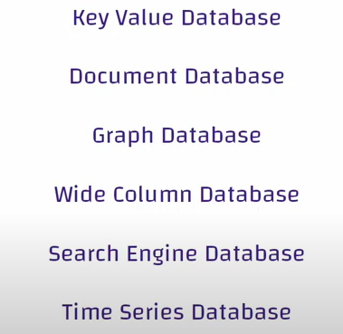
NON-RELATIONAL DATABASE AKA (NO SQL DATABASE)
Non-relational databases, often referred to as NoSQL databases, are a type of database management system that provides a mechanism for storage and retrieval of data that is modeled in ways other than the traditional relational database tables.
These databases are designed to handle large amounts of unstructured, semi-structured, or structured data and offer flexibility and scalability that may be challenging to achieve with traditional relational databases.

Slide 11
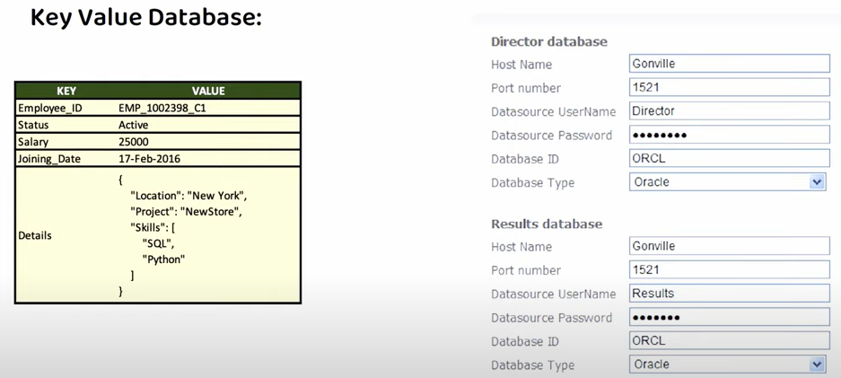
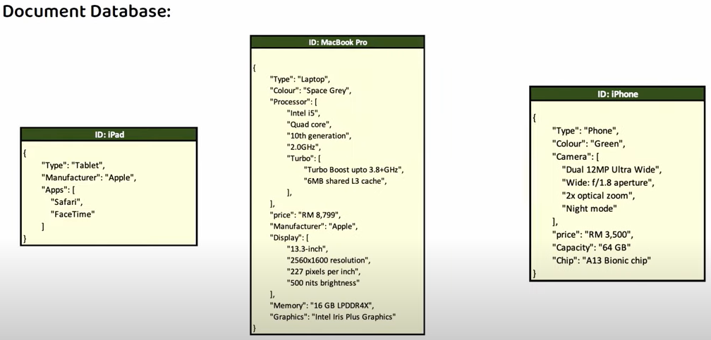
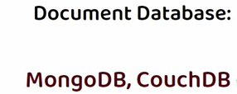
NON-RELATIONAL DATABASE AKA (NO SQL DATABASE)
key value DataBase :
every data stored as a key : value (pair ).
Once you save the data it can retrieve the data by key.
Examples include Redis and Amazon DynamoDB etc
Document DataBase :
Store data in documents.
Typically using formats like JSON or BSON (Binary JSON).
Examples include MongoDB and CouchDB.
There is no specific format to be followed.
each document has follow own format.

Slide 12
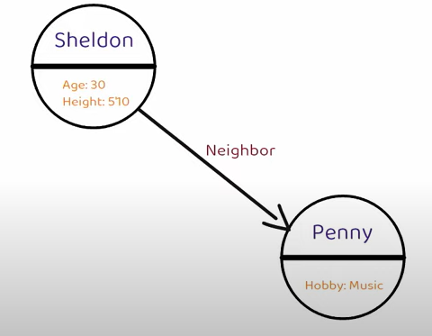
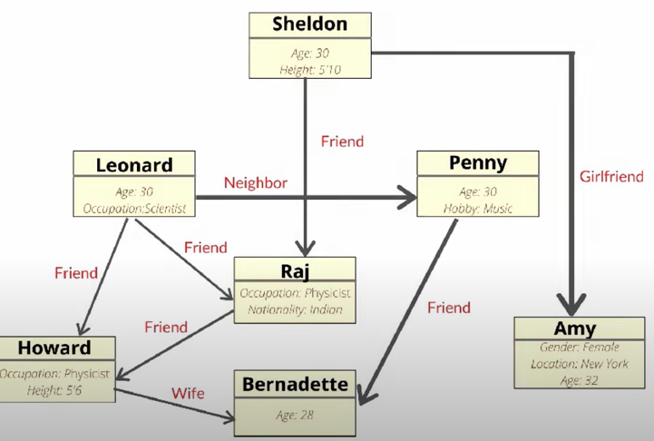
GRAPH DATABASE
- Designed for storing and querying graph-like data structures.
- Examples include Neo4j and Amazon Neptune.
- GRAPH DATABASE forms relation by using nodes, edges, properties.
- Data represent as individual nodes & multiple properties. Between these nodes
edges or relationships are established different types of connection.
- Graph DB will useful when search for specific pattern like money laudring,
Fraud detection etc

Slide 13
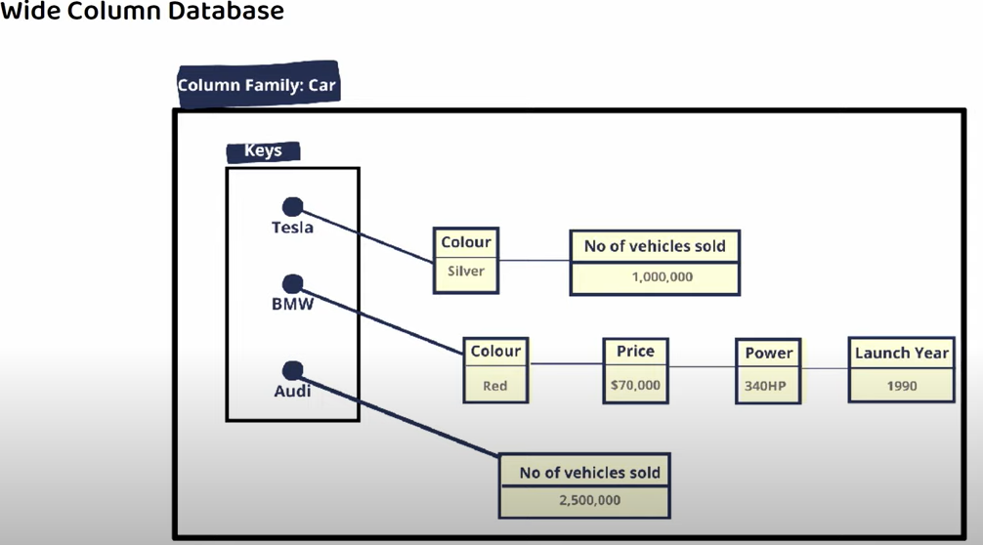

WIDE COLUMN DATABASE or COLUMN-FAMILY STORES:
- Store data in columns rather than rows, suitable for large amounts of data with varying attributes. Examples : Apache Cassandra and HBase.
- Wide column database stored data using rows & columns but they donot use tables. Instead of tables they use structured called as column family.
- Column family contains rows of data where each row has own structure or schema

Slide 14
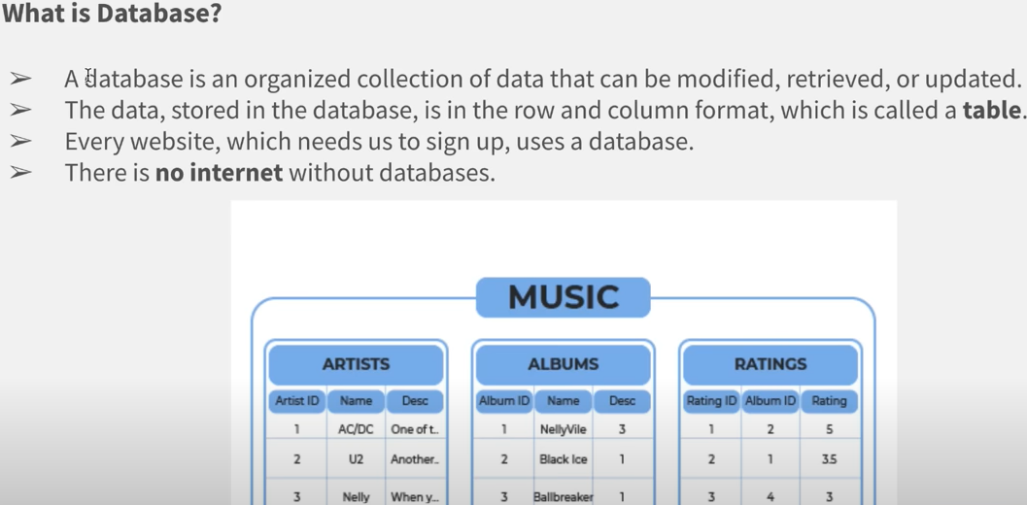
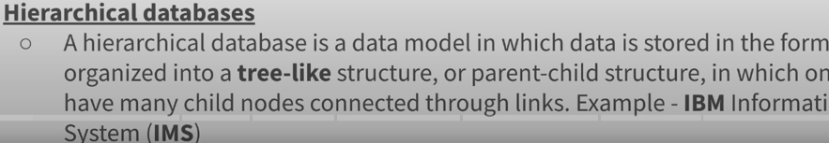

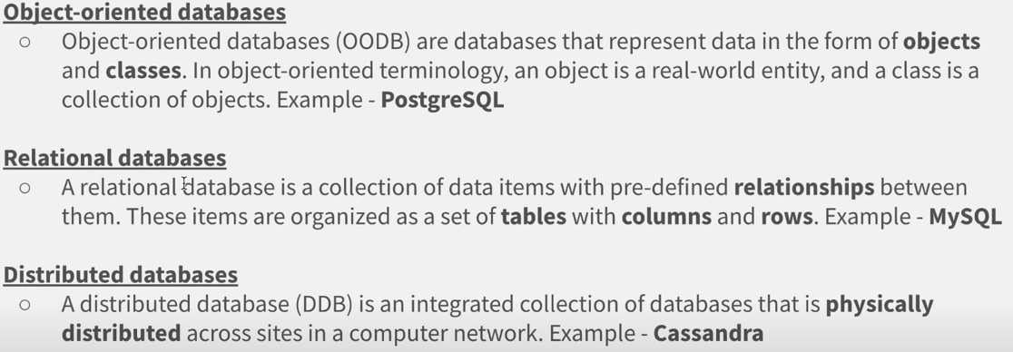

Slide 15
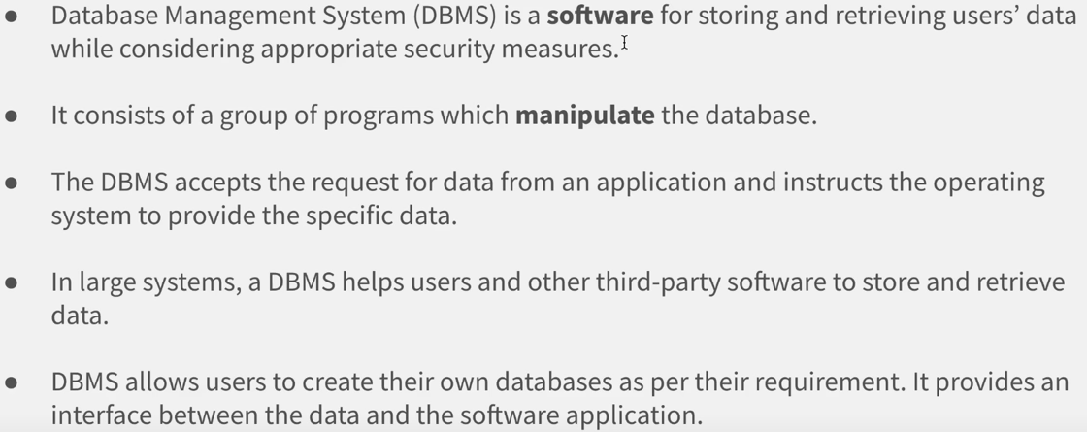
What is DBMS

Slide 16
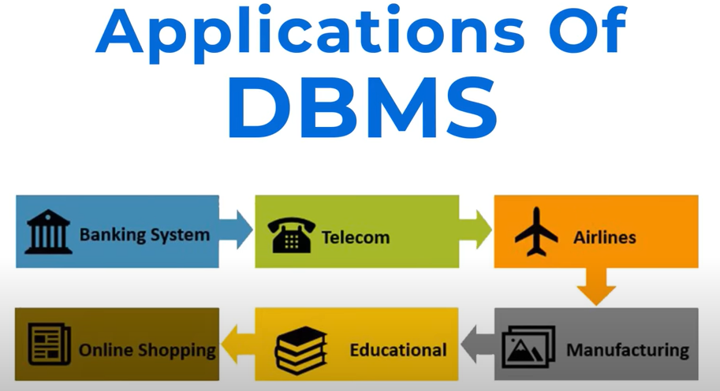
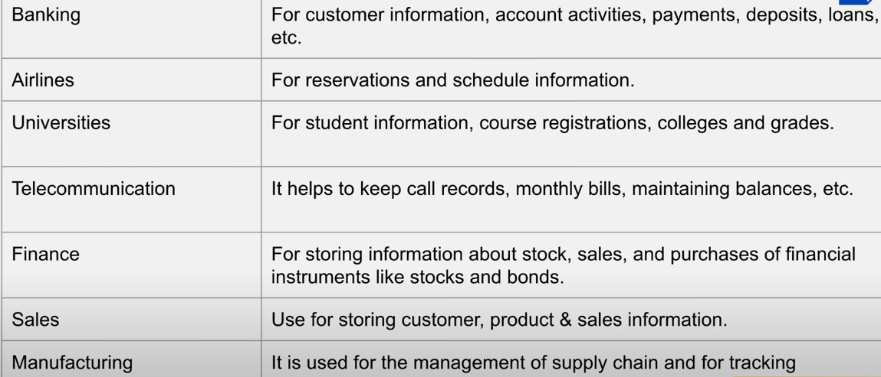

Slide 17
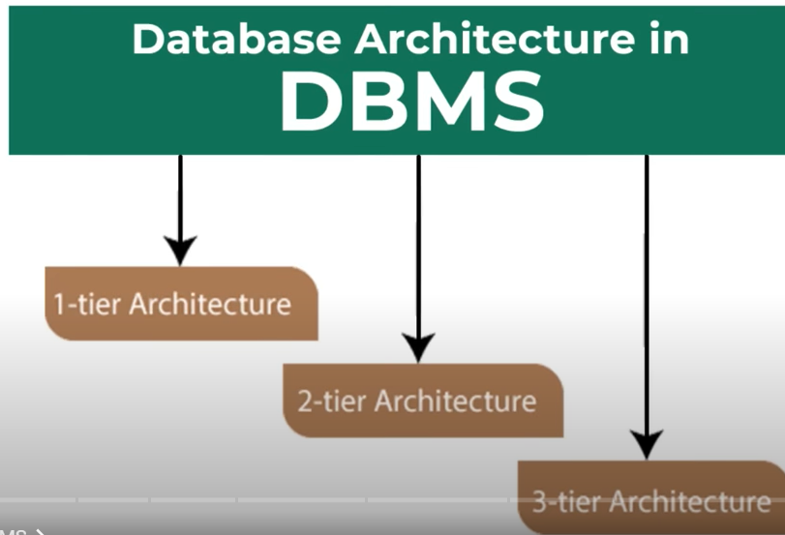
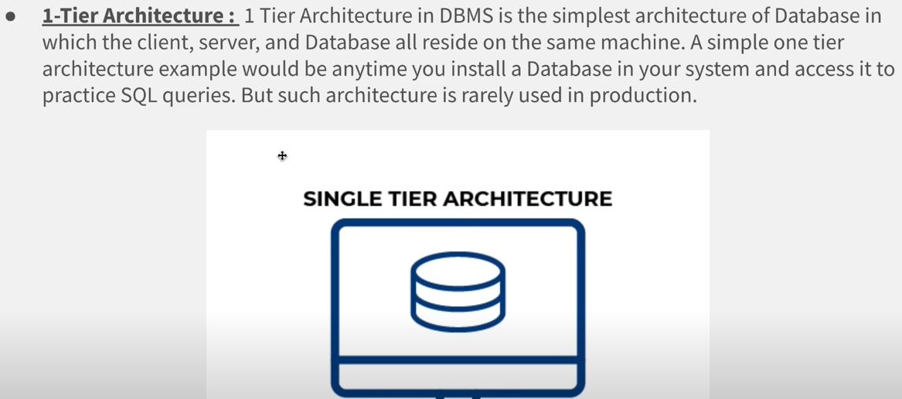
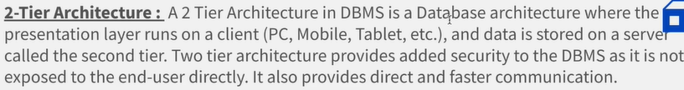
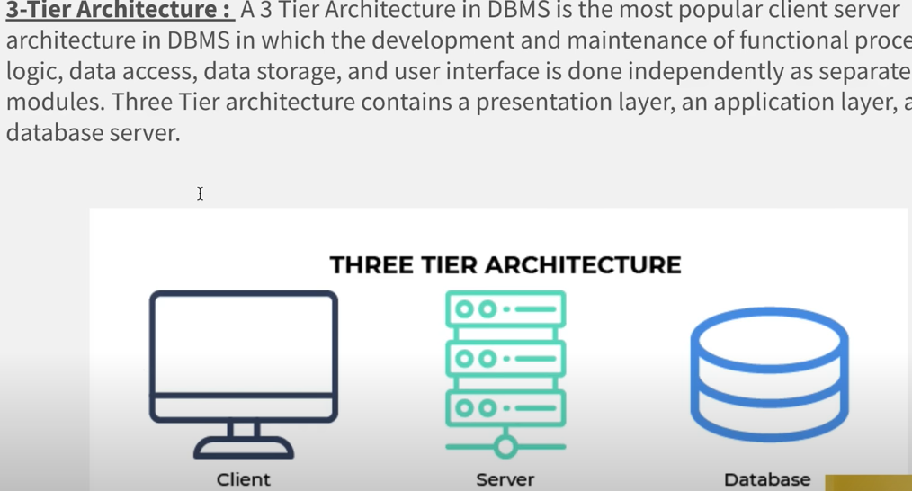
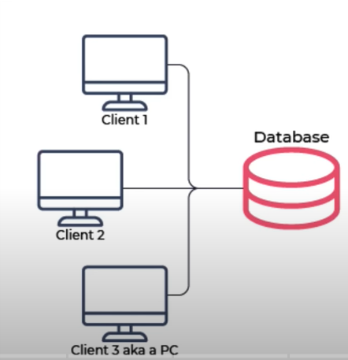

Slide 18
What is my sql? || How to Install MySQL
How to Create a Table in MySQL?
MySQL Add Data Into Tables using the INSERT Query
MySQL Select Query with Where Clause
MySQL Table Constraints Tutorial with Example
MySQL Commands: And, OR & NOT Operator
MySQL IN Operator on Database Table
MySQL LIKE Operator and Wildcard
MySQL Between and Not Between Operators
MySQL Order By and Distinct
MySQL IS NULL and IS NOT NULL Operators
MySQL Limit and Offset Complete Tutorial
MySQL Aggregate Functions: SUM, MIN, MAX & AVG
MySQL UPDATE Statement
MySQL DELETE Query
Primary Key and Foreign Key using MySQL Command
MySQL Data Transaction
Primary Key and Foreign Key in MySQL
MySQL INNER JOIN Command
What is the Difference Between Left Join & Right Join in MySQL?
Cross Join in MySQL
How to Join Multiple Tables using MySQL Command?
What are MySQL GROUP BY & HAVING
Explanation of MySQL SubQuery with EXISTS & NOT Exists

Slide 19




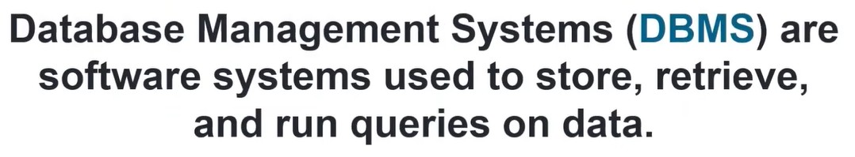
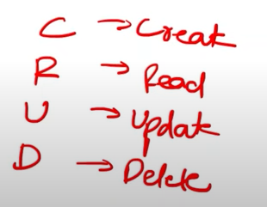
What is mysql
CRUD OPERATION DONE BY DBMS

Slide 20
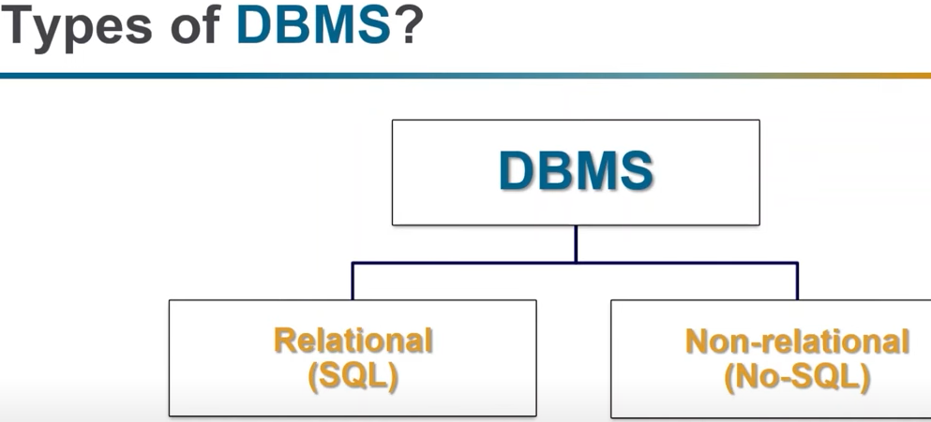
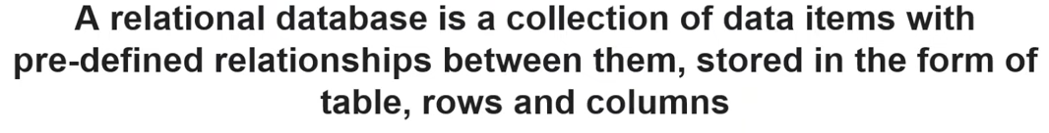

Slide 21
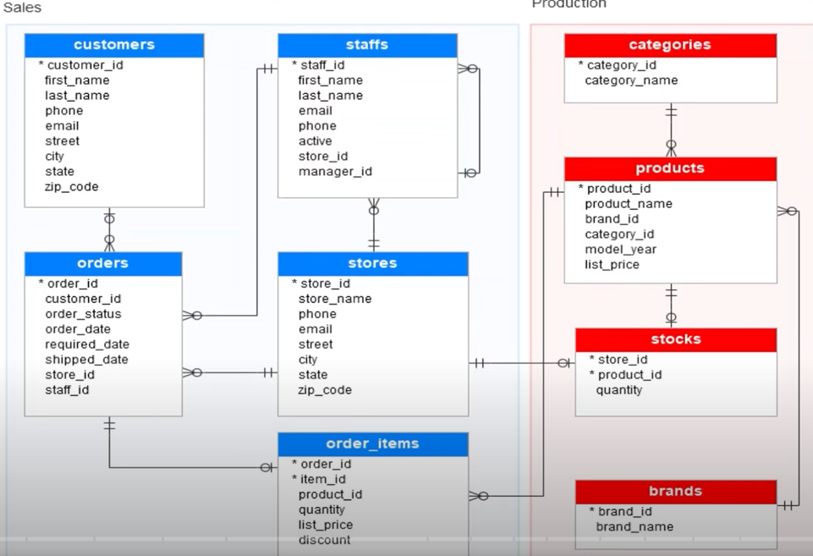
RELATIONAL DATABASE

Slide 22
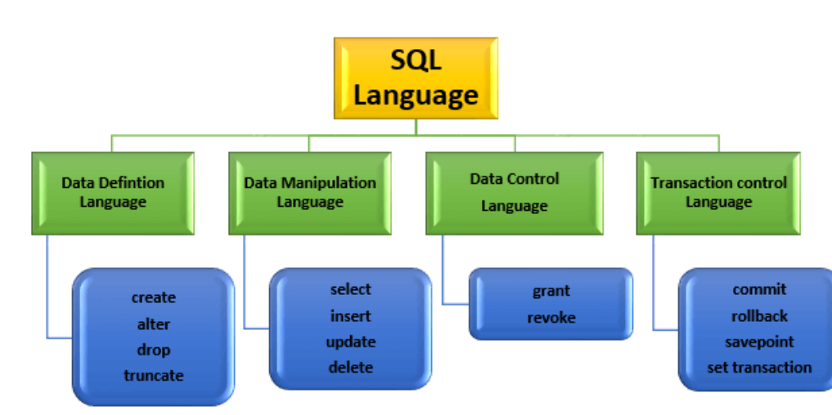
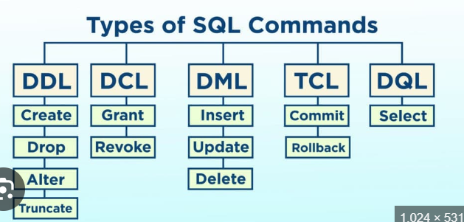

Slide 23
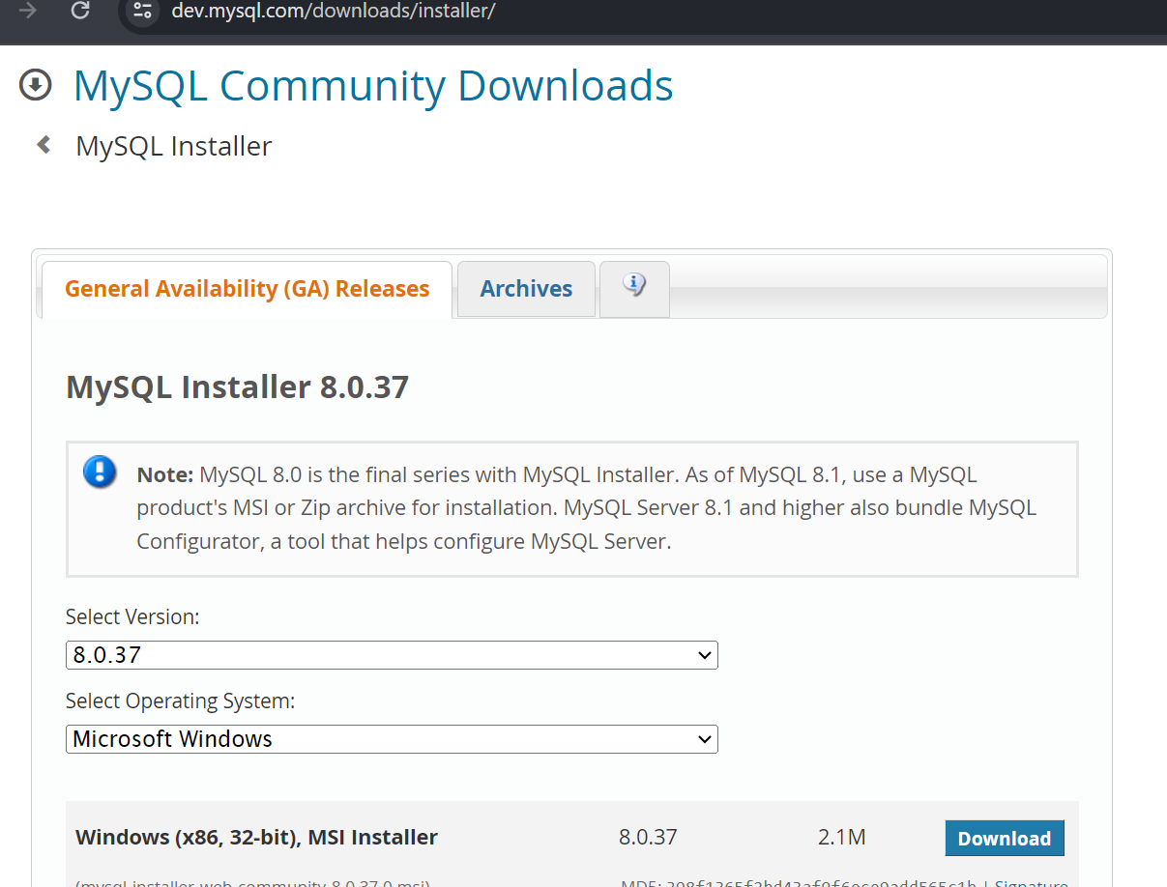
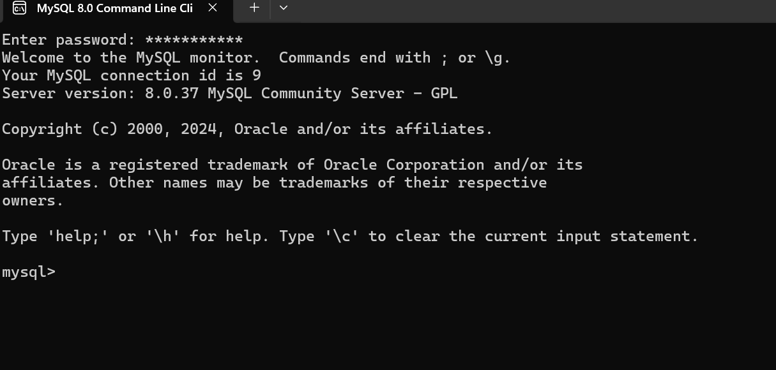
COMPLETE SQL PRACTICLE
My sql is one of the most used database in the world & Steps to download & my sql installation ➔
1- google → mysql download → click on mysql installer or click the below link
2- https://dev.mysql.com/downloads/installer/ → No thanks just start my download
3- click on next – set root password – finish the process
4- start →click on mysql 8.0 comman line interpreter is able to see → type root password

